Slide 1

Virtual classroom based on Website
follow
idea
THEME: Ed-Tech
TEAM NAME: C.R.U.S.H.
Student Names: Dev Patel,
Krushil Mehta,
Prerna Gupta
services
teams
timeline
Introduction

Slide 2
PROJECT TITLE: VIRTUAL CLASSROOM BASED ON WEBSITE
PROJECT DESCRIPTION:
COVID-19 has imposed a major challenge on the education department. Due to shut down of educational organizations the students are unable to complete the syllabus.
We have developed a website which will help us overcome this challenge
The Virtual Classroom System replaces the manual system with online Classroom.
In Virtual Classroom System the students and faculty need not attend the classes physically ,the teaching sessions are carried out through online.
Here the student has the freedom of choosing the faculty and class he wants to attend.
follow
teams
services
flowchart
THEME
INTRODUCTION

Slide 3
OUR APPROACH TO SOLVE THE PROBLEM
The teachers can upload the lecture on daily basis.
Entire website is bifurcated according to the stream which Is further divided according to the academic year.
We have used the server of YouTube for streaming the videos online this will make the system extremely cost efficient and eradicates the need of using database.
follow
teams
services
flowchart
THEME
INTRODUCTION

Slide 4

HTML5
CSS 3
JAVA SCRIPT
MICROSOFT AZURE STORAGE ACCOUNT
MICROSOFT AZURE SERVER LESS FILES
MICROSOFT AZURE CONTAINERS
Tools & technology
follow
Theme
services
teams
Tool & technology
Introduction

Slide 5




FUTURE SCOPE : Following features may be added to enhance the website
Online Exams
Elastic to change in network issues
An interface can be developed wherein the exams can be conducted from home itself
Incase of network issues data can be stored in local host. Hence, the attendance will be marked inspite of network issues
history
follow
Question & Answer
use
services
teams
Assignment
about
The students can ask the doubt using the website .
The teachers can upload the assignment or tasks to the students

Slide 6
Outcome:
Link of the website:
https://edtechweb.z30.web.core.windows.net/
weakness
history
services
teams
timeline
about

Slide 7
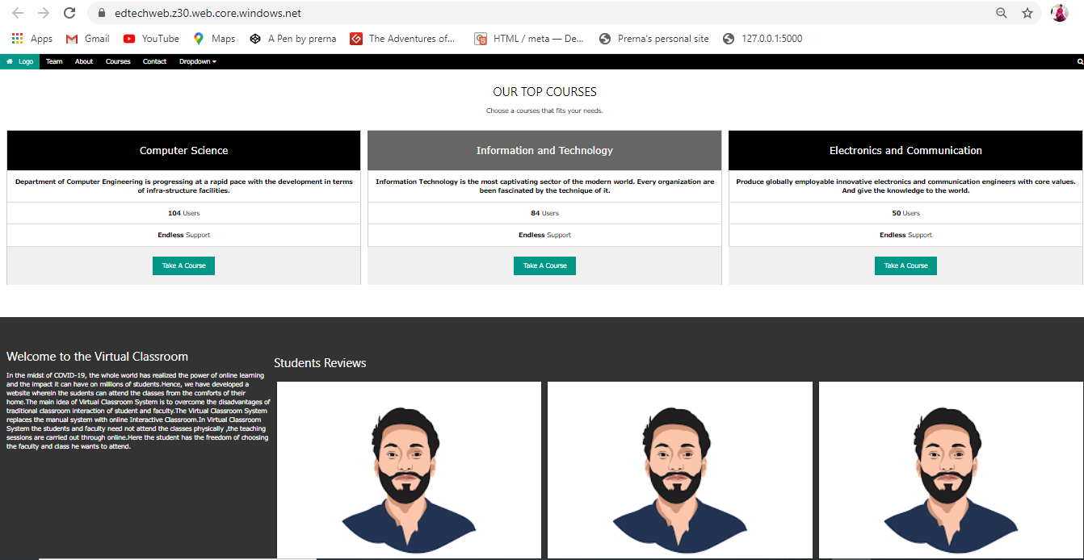

Slide 8
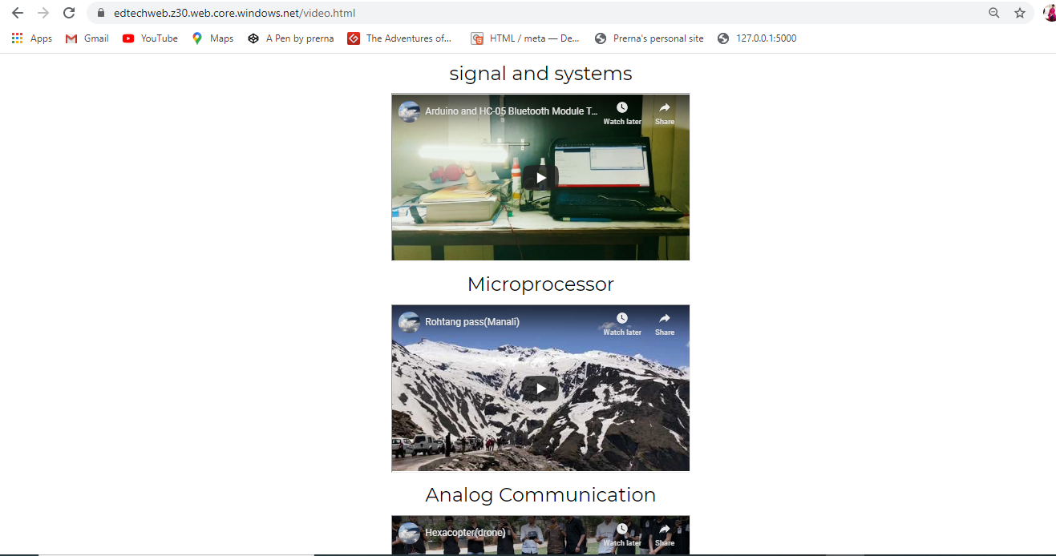

Slide 9
References
https://youtu.be/gYpNC_tdbQQ Ahern, T.C. & Repman, J. (1994) The effects of technology on online education. Journal of Research on Computing in Education, 26(4), 537-546. Knowles, M. S. (2012). Self-directed learning: A guide for learners and teachers. New York: Association Press. • "The Independent Learning Contract System: Motivating Students Enrolled in College Reading Courses" by Jerry J. Lewis, Reading Improvement, Vol 41, No 3, pp 188-194, Fall 2004.
references
services
history
snapshot
about

Slide 10

End
history
services
teams
timeline
about

